Slide 1
Assignment 2-Part 2
COP 290 - Spring 2023-24
Vipul Vaibhav 2022CS11301
Rajarshee Das 2022CS11124

Slide 2
1.1)Brief intro about our game
Here is an abstract of our game:-
Our game is based in a park, where we need to clean it, at the same time we also need to catch the kids who are littering the park under a given time constraint.
This game has been developed with Pygame, mostly from scratch.
The goal of this game is to give a social message to always keep our surroundings clean and we tried to do this in a Fun and Competitive way.

Slide 3
1.2)Brief info about our game
We organised our game structure into various files and classes which serves different purposes and aspects of the game. So this highly structured code ensures that this game can be scaled with much more complexity. What we laid out is a basic framework to deploy this product into production.
We used storage elements like JSON to save HIGH Scores. However to ensure that this data can’t be tampered at any cost, we can connect it to encrypted server based databases.

Slide 4
2) What optimizations were made in our game?
We used delta time to model any kind of movement, animation, rotation, etc of our game objects. Delta time = 1/frames per second. This ensures that any kind of movement is uniform irrespective of the frames per second that your machine supports. This ensures that players with both low and high end support machines experience same type of movement of game objects.
We also didn’t load the whole map or any gameobject at the same time. We loaded only those gameobjects/map which are visible on the player’s screen. This ensures that we don’t load unnecessary sprites on the screen.

Slide 5
3)How we made our gamemap using Tiled software and incorporated it into our game?
We used Tiled, a software designed for making game maps, to build our maps. The map that we created is a .tmx file. We used pytmx pip package to import tmx data of our map which was exported by Tiled. Using pytmx, we differentiated between different kind of object layers and Tiled layers and used them accordingly in our Level formation with different properties. For example:- Water tile layers were treated differently than other layers because they were animated while ground tile layers were not animated.

Slide 6
4.1) How we made our Camera?
Camera as a concept doesn’t exist in pygame. So instead of moving our player, we moved all other sprites(including player). For example:- If player moved x dist from SCREEN_WIDTH/2 and y dist from SCEEN_HEIGHT/2(i.e. Center of the map), then we moved all sprites by x and y dist in opposite directions accordingly. This ensures that our player char remains at the center of the screen.

Slide 7
4.2) How we made our Camera?
We differentiated different game objects into diff. LAYERS, this ensures that those gameobjects which should be behind another object in this 2D are actually behind. This ensures that all sprite objects are rendered on the screen in order. For example:- Water layers should be behind ground layers. So water layer gets a layer no. of 0 and ground layer gets layer no. of 1.
We also gave a nice fake 3D effect for objects which are on the same layer. We sorted the objects based on their y-position on screen. The game objects which have more y-coordinate should be rendered later on the screen. Fake 3d showcase on next slide.

Slide 8
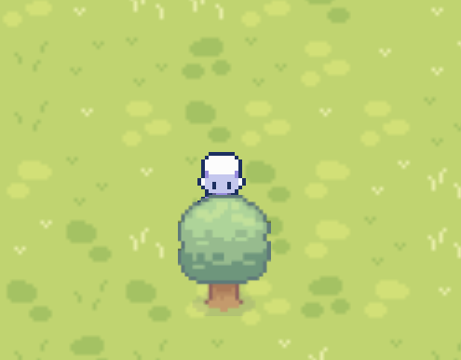
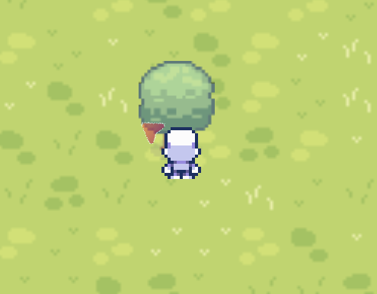
4.3) How we made our Camera?
FAKE 3d EFFECT

Slide 9
5.1) What type of collision mechanisms we used?
We used two types of collision mechanisms:-
Static Collision detection
Dynamic Collision detection (can also be applied between two moving objects)
We used static collision detection for the Player character since it’s direction is determinate where it will go since that is defined on user-input basis.
However we used dynamic collision detection for Enemy characters since we made its movement completely random and it is difficult to check from which side it collided if we just use static collision detection.

Slide 10
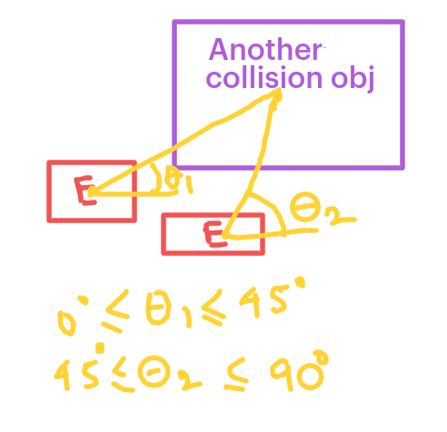
5.2) What type of collision mechanisms we used?
Dynamic Collision detection explanation:-
So what we did is we disintegrated this problem into 8 cases each case covering 45 degrees. 45*8=360.
For example here:- when 0<=theta<=45, it means right side of hitbox of enemy collided with left side of hitbox of collision obj and if 45<theta<=90, it mens top part of enemy collided with bottom part of collision obj.

Slide 11
6.1) User Interface
Our game has various interesting UI elements:-
Buttons: We implemented a button class in pygame, for making buttons like, start, exit, continue in Main Screen.
Main Menu: We made a main menu for our game by filling the screen with a particular color whenever the game_state variable is changed. This happens in the same screen by filling colour over and over again. We could have also done this using multiple game screens, but due to simplicity of the former, we used single screen.

Slide 12
6.2) Overlays
We added various overlays in our game like, 1. A timer on top of the screen, which can be paused when user returns
2. High score, kids left and garbage left over lay on bottom right corner of the screen, when kids left and garbage left becomes 0, the game gets over and we return to a game over screen
3. Everytime we get a powerup like Fast Boot or magnet we get a temporary overlay on the bottom left corner for the same duration.
4. When the player uses magnet power-up, a red circle forms around the player which shows the range of the magnet
5. Whenever there is an enemy outside the player’s screen, there is a red pointer showing the enemy’s direction around player’s char. This helps player navigate the map easily.

Slide 13
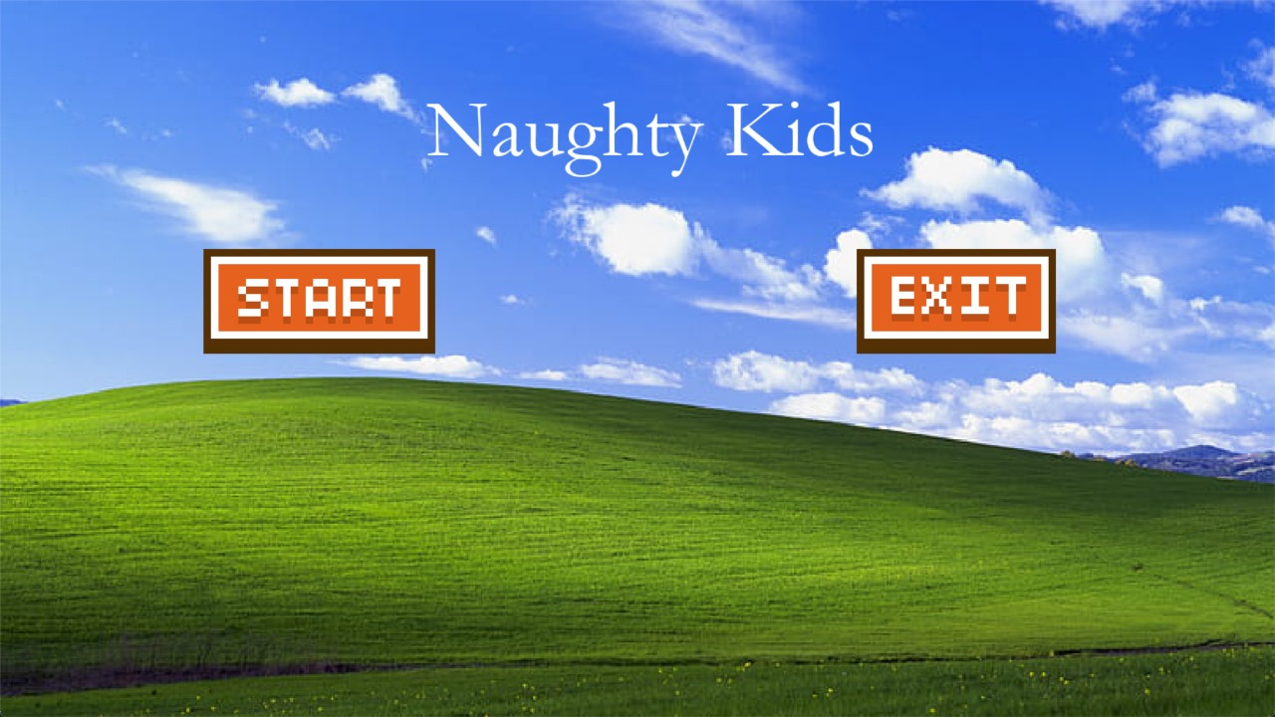
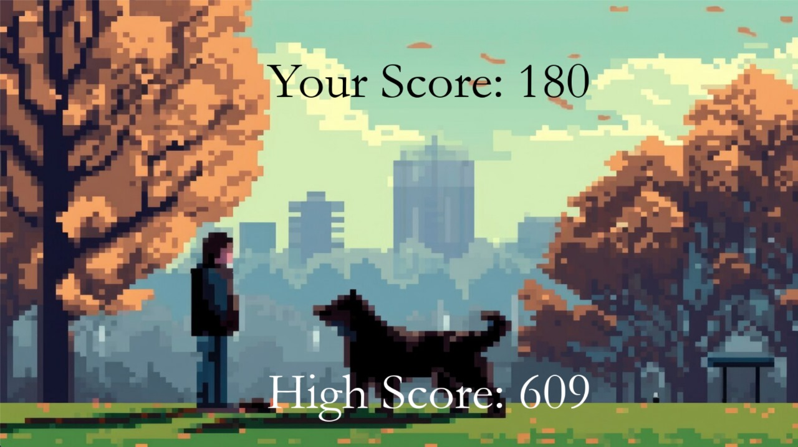
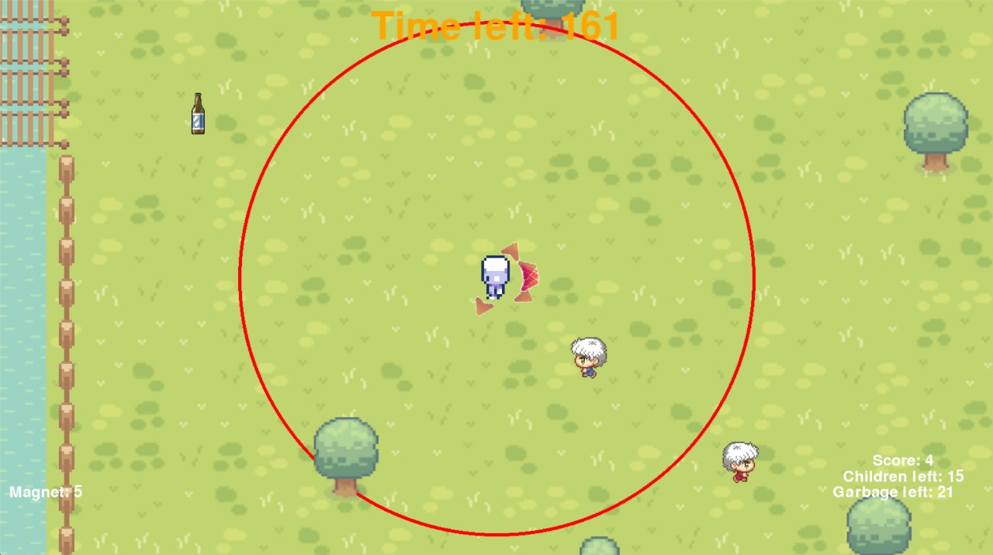
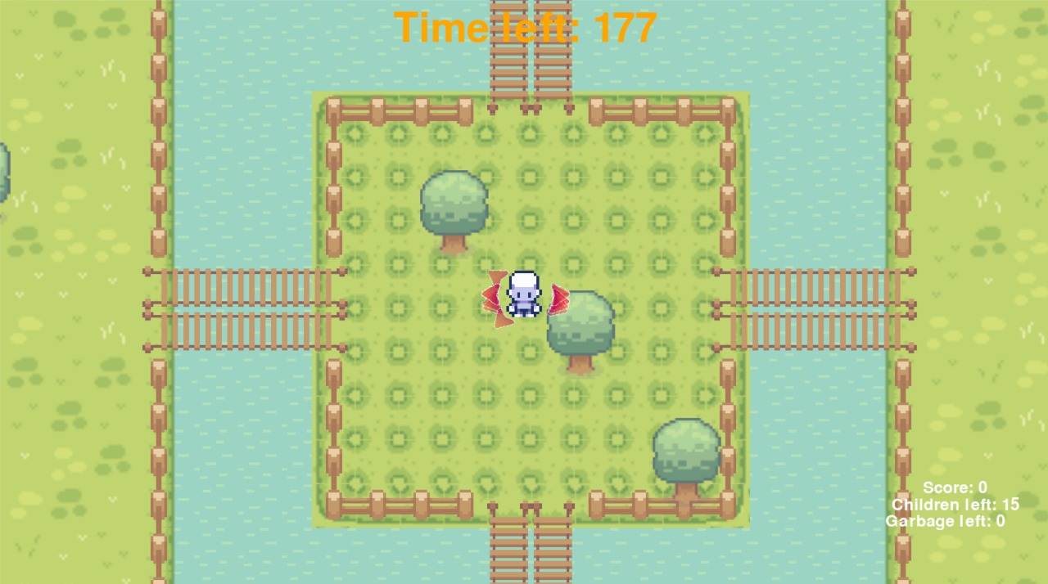
6.3) UIs and Overlay’s screenshots

Slide 14
6.4) UIs and Overlay’s screenshots

Slide 15
7.1) Miscellaneous effects/items
Particle effects
We used pygame masks to perfectly copy the image’s surface and turned into white surface and killed this object. This particle effect was used whenever we catched the enemies/garbage or collected power ups from the ground.
We added powerups like magnets(which can collect garbages in a certain radius), FastBoots(which doubles the speed) and TimeAdder(which increases the Time required to complete the game). This adds extra effects into the gameplay aspects of the game.

Slide 16
Miscellaneous effects/items
3) Music
We added music into our game when it is running and it gets paused when we return to main menu. Button clicks also have different sound effect on click.
4) Tried to Integrate AI
We tried to build our own component of AI which was built on top of pygame-ai library which tries to Flee from Player object while also maintaining obstacles/collisions which adds sheer complexity to this AI module. We did successfully built it however due to sheer complexity of this aspect, we were not able to integrate this component into our game before deadline.

